Slide 1
Applications, Markets and Technologies for Distributed Power
National Energy Modeling System
Annual Energy Outlook Conference
Washington, DC
March 27, 2001
Joseph Iannucci
Principal
Distributed Utility Associates
1062 Concannon Blvd.
Livermore, CA, USA 94550
925-447-0624
joe@dua1.com

Slide 2



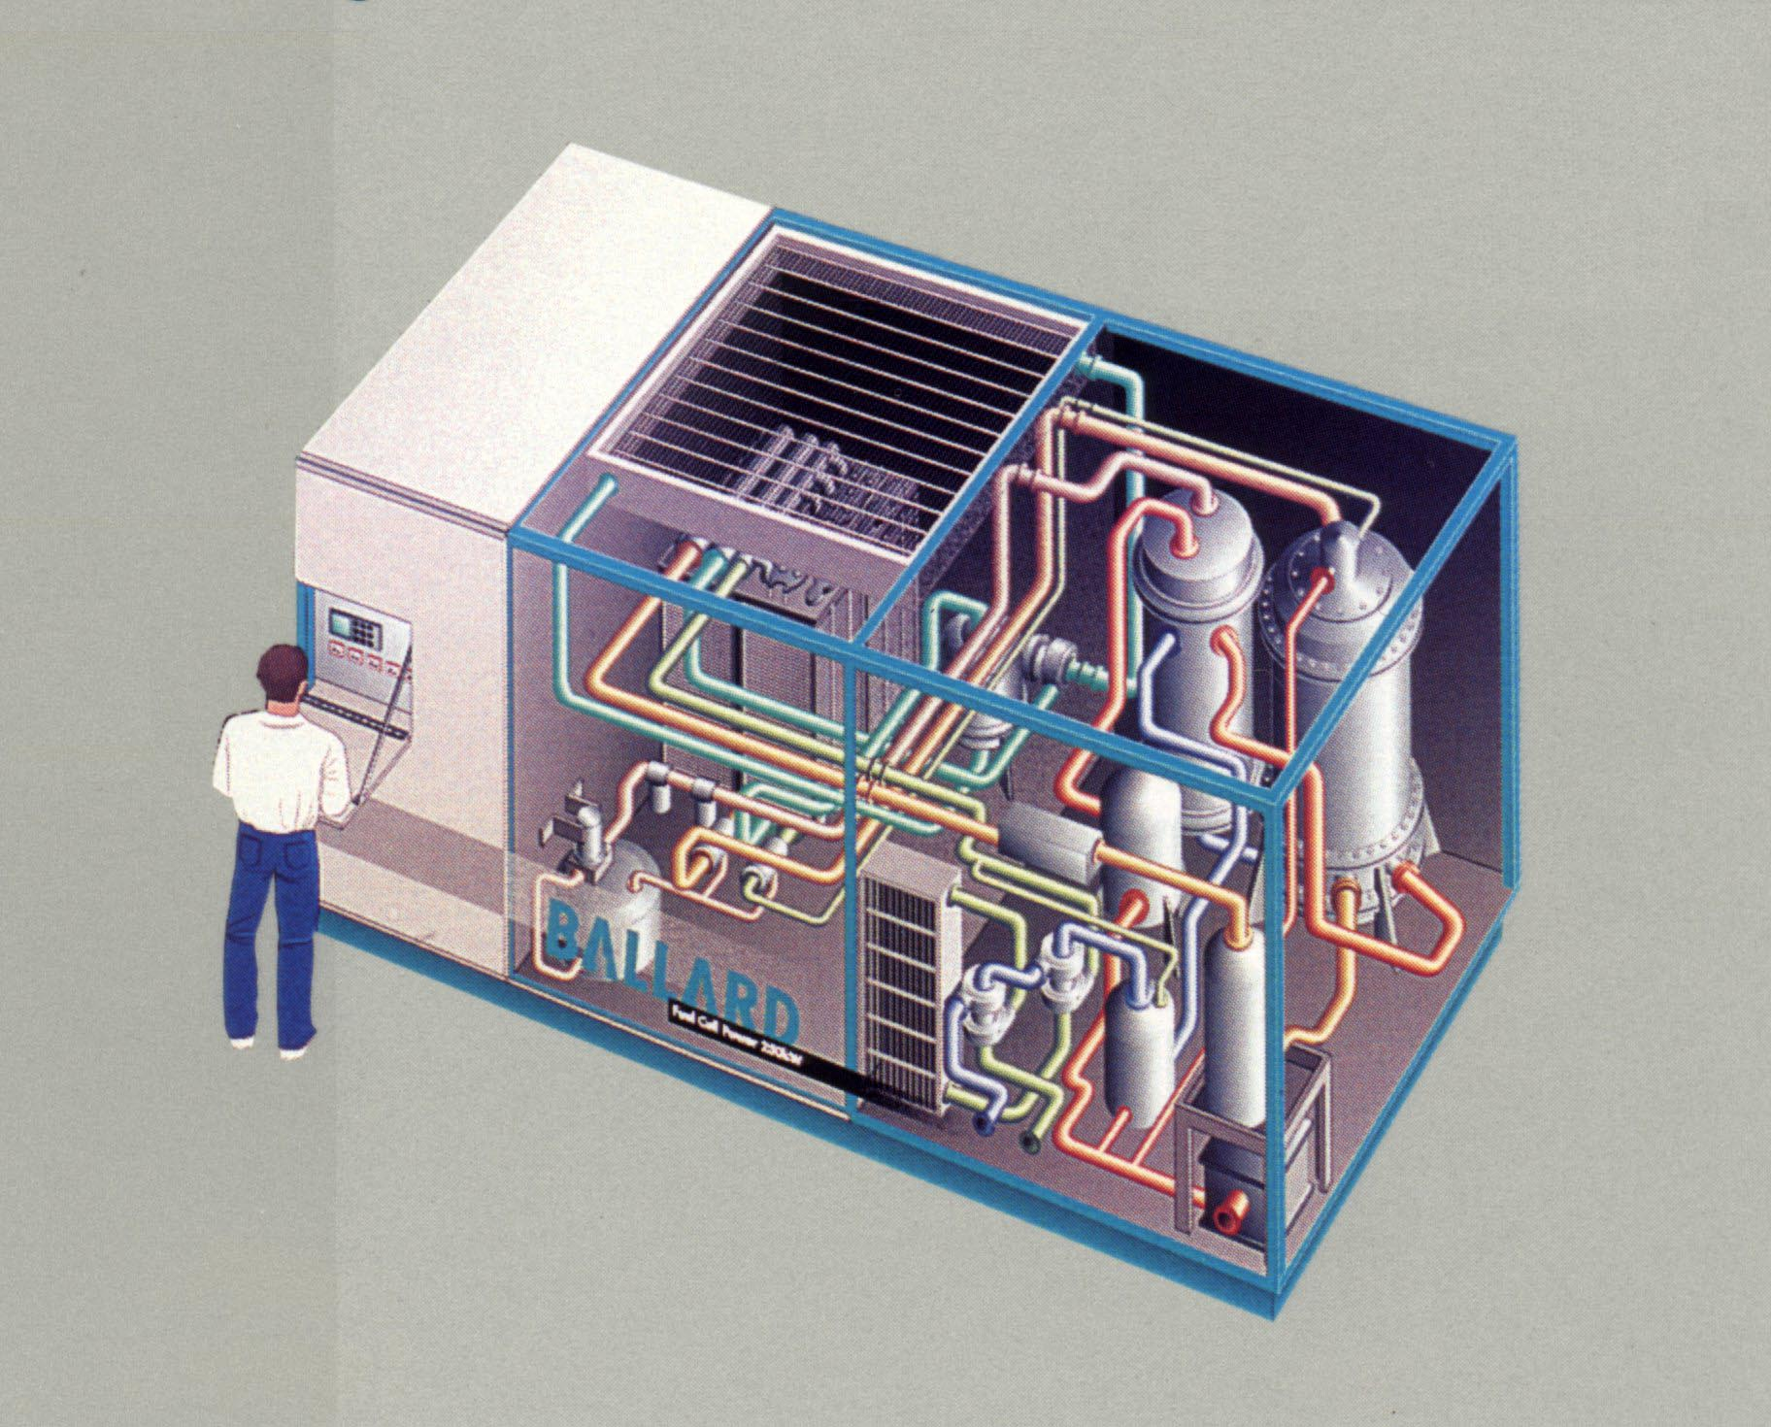


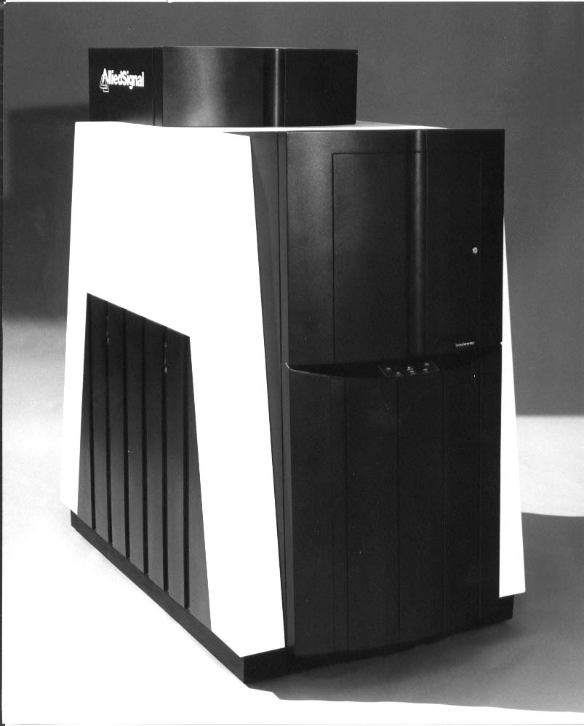
Today's
Central Utility
Tomorrow's
Distributed Utility?
Central Generation
Central Generation
Wind
Remote
Loads
Genset
PV
Fuel Cell
Battery
Customer
Efficiency
Customers
Microturbine
©2000 Distributed Utility Associates

Slide 3
Concept: Expanding the
Value Definition
From...
$/kWh
To...
Environment
$/kWh
$/kW
Bulk Energy
Distribution
Transmission
Peaking Generation
Customer Reliability

Slide 4
Recent Distributed Resources News
Interconnection Standards: IEEE P1547, Texas, PJM, California, New York, etc.
ComEd 100 MW Summer Diesel Rental
ComEd “Neighborhood DR Project”
Omaha Bank Six Nines
Flywheel/Fuel Cell/Microturbine Alliances
Residential fuel cell buzz
DG market capitalization >> $1B
Tacoma Power 30 1.6 MW engines

Slide 5
Market Segmentation
1. Electric Generation/“Utility”
2. Customer (Residential, Commercial, Industrial)
Leading Applications
Market Models
Technologies

Slide 6
Utility Case Examples
Distribution substation upgrade in urban location
Improve local reliability in commercial office park
Upgrade radial line (capacity) serving seasonal agricultural loads with increasing peak demand but relatively flat energy sales

Slide 7
Comparing Central and
DU Solutions
DUVal
g,
fuel,
G,
T,
D,
[cogen],
[VOS], [Env.]
FUEL

Slide 8
The Distributed Utility Opportunity:
Improved Asset Utilization
Typical System Load and Percent of Feeder Maximum Load
100
90
System
80
Electric Generation
Asset Utilization
70
Load
Factor
Percentage
(%)
60
50
Typical Feeder
40
30
Distribution
Asset Utilization
20
System
Typical Feeder
10
0
0
10
20
30
40
50
60
70
80
90
100
Percentage of the Year (%)
©2000 Distributed Utility Associates

Slide 9
Leading Utility-Perspective Technologies
Peaking applications dominate
Activating fleets of standby generators
Reciprocating engines, especially natural gas-fired
Small gas turbines (e.g., ATS)
Medium gas turbines - 10 MW+
Control systems to manage the above

Slide 10
Next Utility-Perspective Technologies
Advanced gas-fired reciprocating engines
Storage technologies
Fuel cells (baseloaded)

Slide 11
Customer Perspective
DUVal-C
Cost and
benefits of
DG options
Purchasing
power

Slide 12
Customer Distributed Resource Applications
Premium Power
Standby Power
Peak Shaving
Low-Cost Energy
Combined Heat & Power

Slide 13
Leading Customer-Perspective Technologies
Activating & refurbishing standby generators
Cogeneration of all types and sizes
Reciprocating engines that are permittable
Anything that can make electricity (microturbines, etc.)
“Data Hotel” systems (recips plus batteries plus controls)
Advanced storage systems (flywheel, UPS, etc.)

Slide 14
Next Customer-Perspective Technologies
Advanced gas-fired reciprocating engines
Fuel cells
Renewables

Slide 15
Comments on AEO 2001
Data
Methodology
Electric Generation (“Utility”)
Customer Perspective
  residential
  commercial
  industrial

